Slide 1

INDIAN INSTITUDE OF INFORMATION TECHNOLOGY
NAGPUR
SMART AC SYSTEM
ELECTRONICS AND COMMUNICATION ENGINEERING

Slide 2

PRESENTED BY :
ASHISH PATHAK (BT21ECE040)
ABHISHEK GAWANDE (BT21ECE025)
OM TELRANDHE (BT21ECE009)
SOUBHIK ROY (BT21ECE002)
SHUBHENDU KUMAR (BT21ECE066)
UNDER THE KIND GUIDANCE OF :
DR. PARITOSH PESHWE

Slide 3
AIM OF THE PROJECT:
To Control the Temperature of the Room.
This system opens/closes six AC vents based upon the current temperature in the Room. The temperature is maintained at a pleasant 20 –25 0C. The AC vents can be gradually opened / closed. This is done in accordance with the temperature in the room. The room is a fairly large sized room so 6 temperature sensors are placed at different points of the room. Each sensor and AC vent is associated with part of the room. You can assume that the room is broken up into 6 sub-areas each with its own sensor and ac vent.
User Interface: LCD displaying Temperature in 0 C.
Single push button to vary temperature between 200C – 250 C.
To minimize manual intervention using an intelligent processor (8085 microprocessor).
It control the temperature of any industrial plant.
This type of temperature Controlled System can also b implemented in automobile.

Slide 4
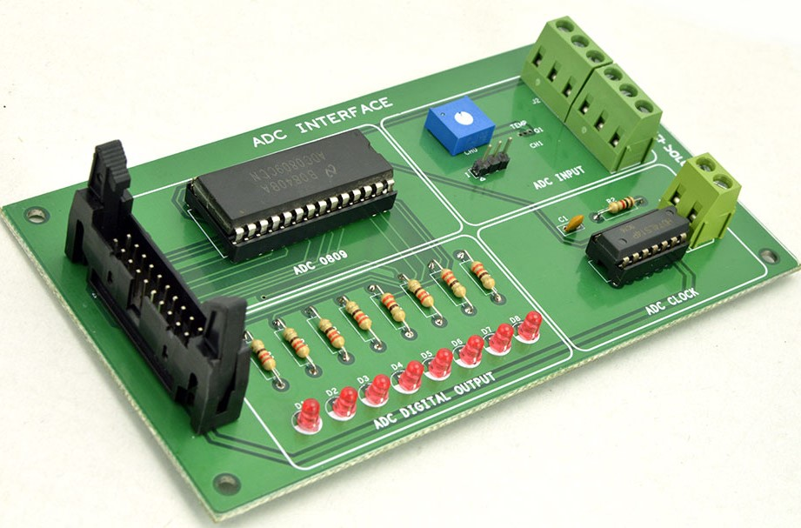
ANALOG TO DIGITAL CONVERTOR
AN AUTOMATIC TEMPERATURE CONTROL UNIT MAINLY DIVIDED INTO THREE PARST:
01
Temperature input unit
02
Processing unit
03
Control output unit

Slide 5
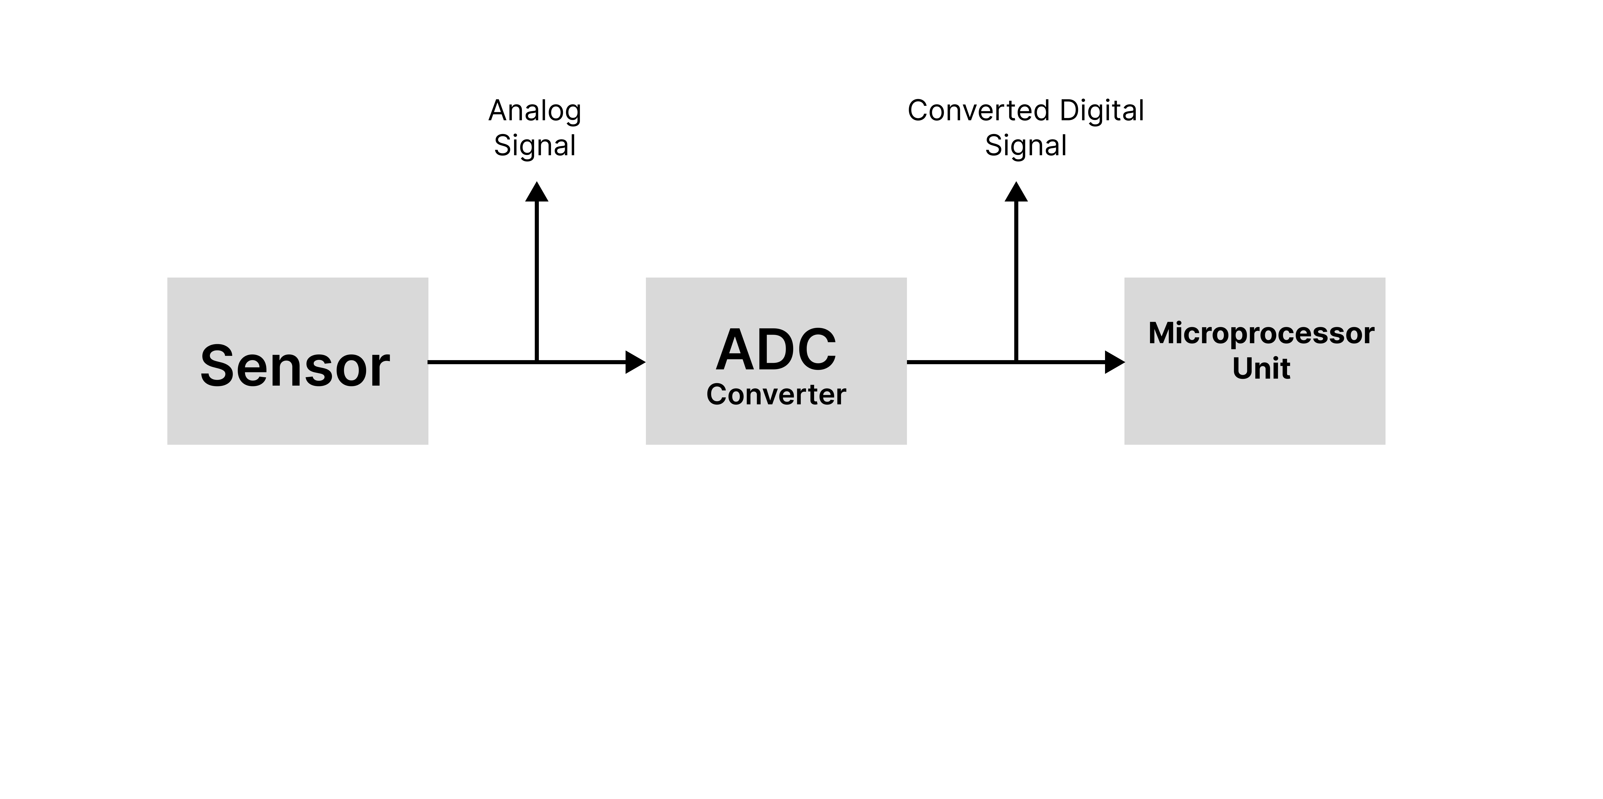
Basic Block Diagram & Architecture of
ATC System

Slide 6
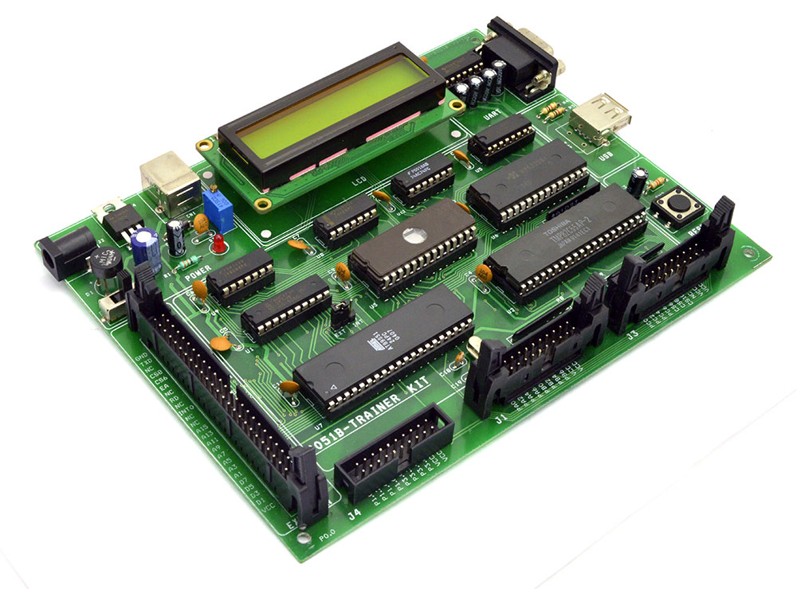
The 8085 Trainer Kit consists of
8085 MPU IC
16KB EPROM
8KB RAM
Display Controller 8279
Programmable Peripheral Interface 8255 (PPI)
​Alphanumeric LCD Display with Backlite.

Slide 7
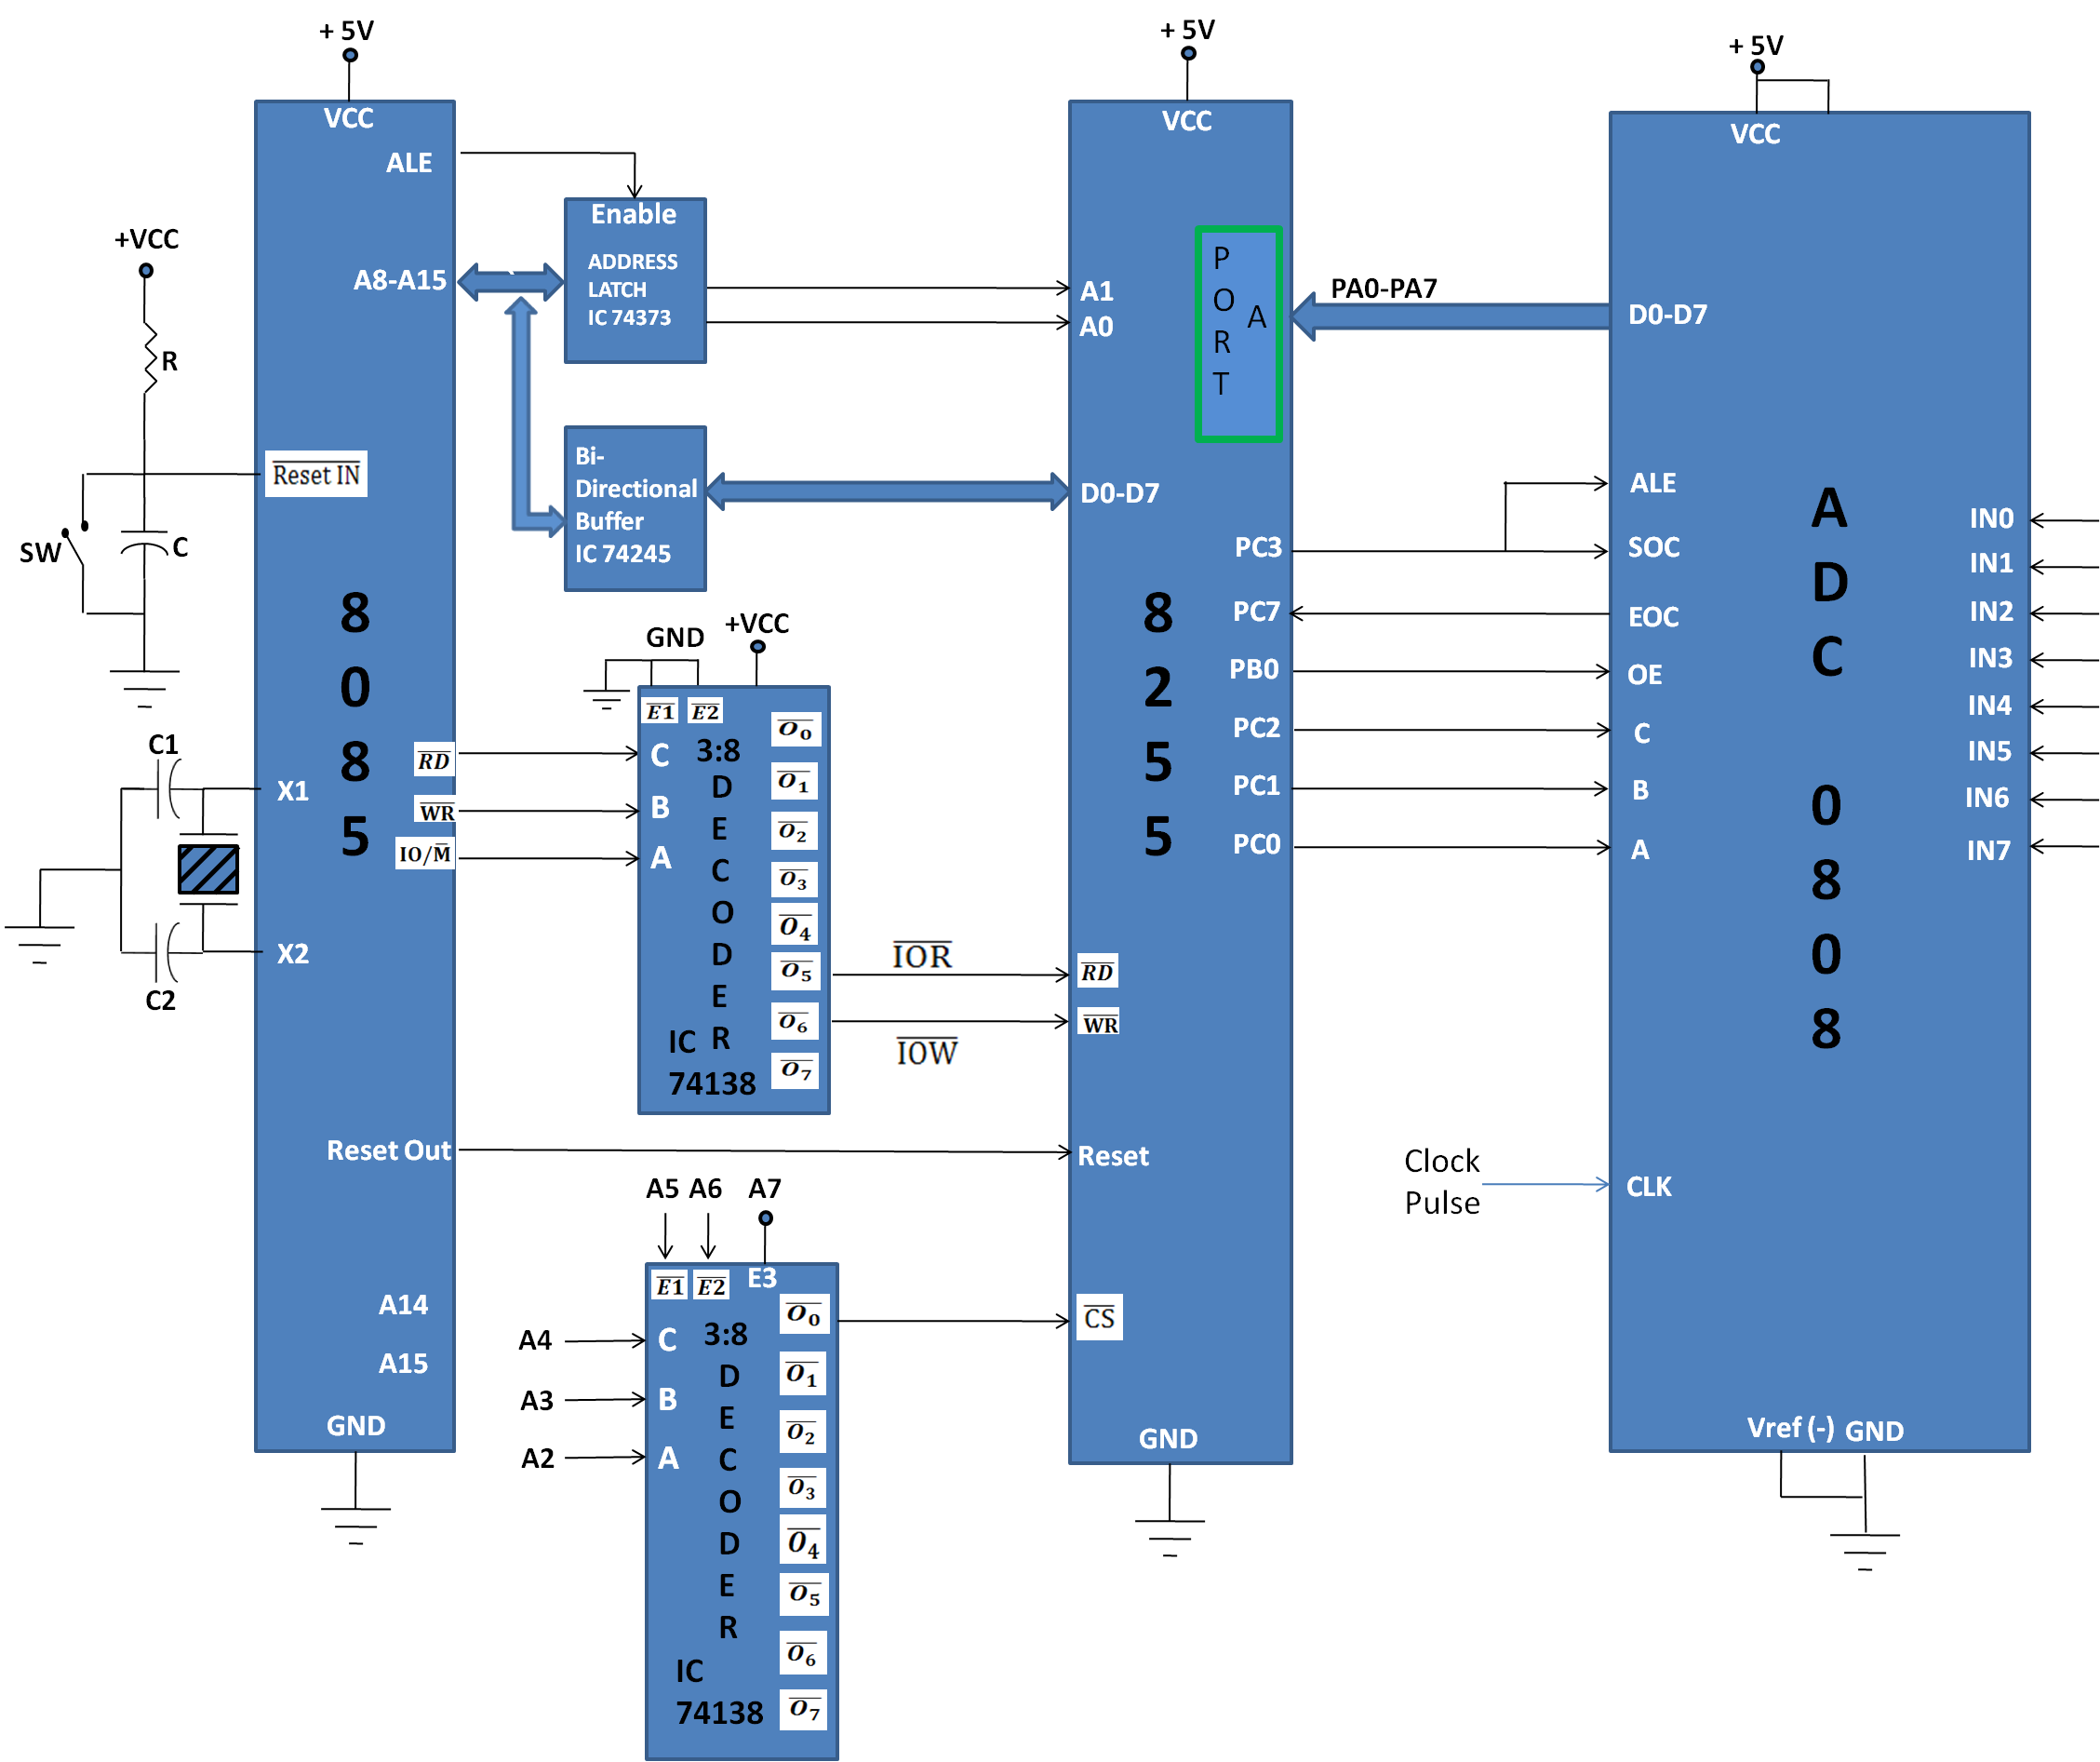
INTERFACING ADC0808 WITH 8085

Slide 8
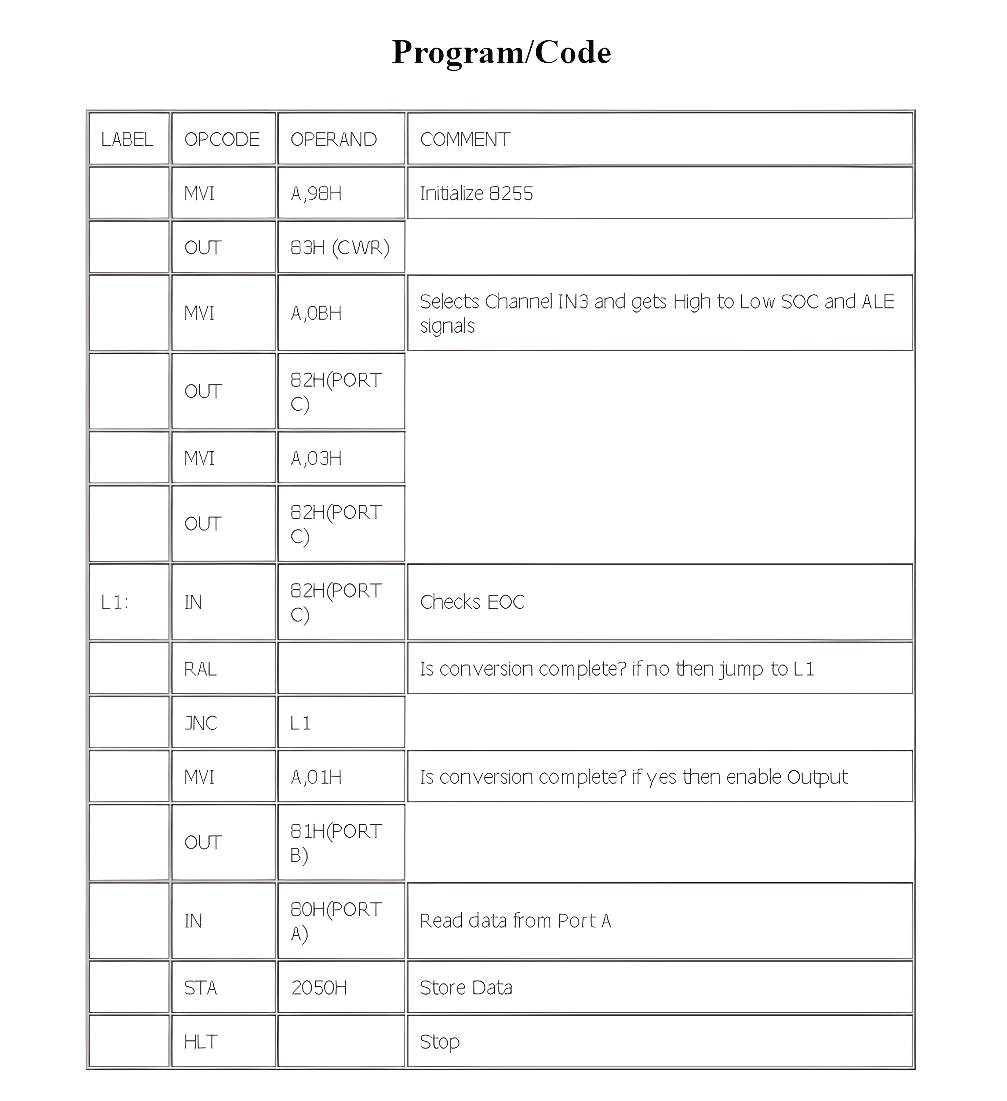

Slide 9
Interfacing Diagram

Slide 10
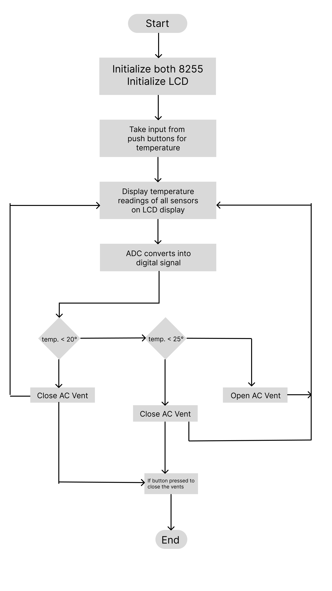
Flowchart

Slide 11
Main Program Code
LXI H, Add
MOV A,M
MVI B, 14H
CMP B
JNC L1
MVI A, 00H
OUT PORT
MVI C, 19H
CMP C
JC L2
MVI A, 01H
OUT PORT
MVI A, 00H
OUT PORT​
L1 :-
L2 :-

Slide 12
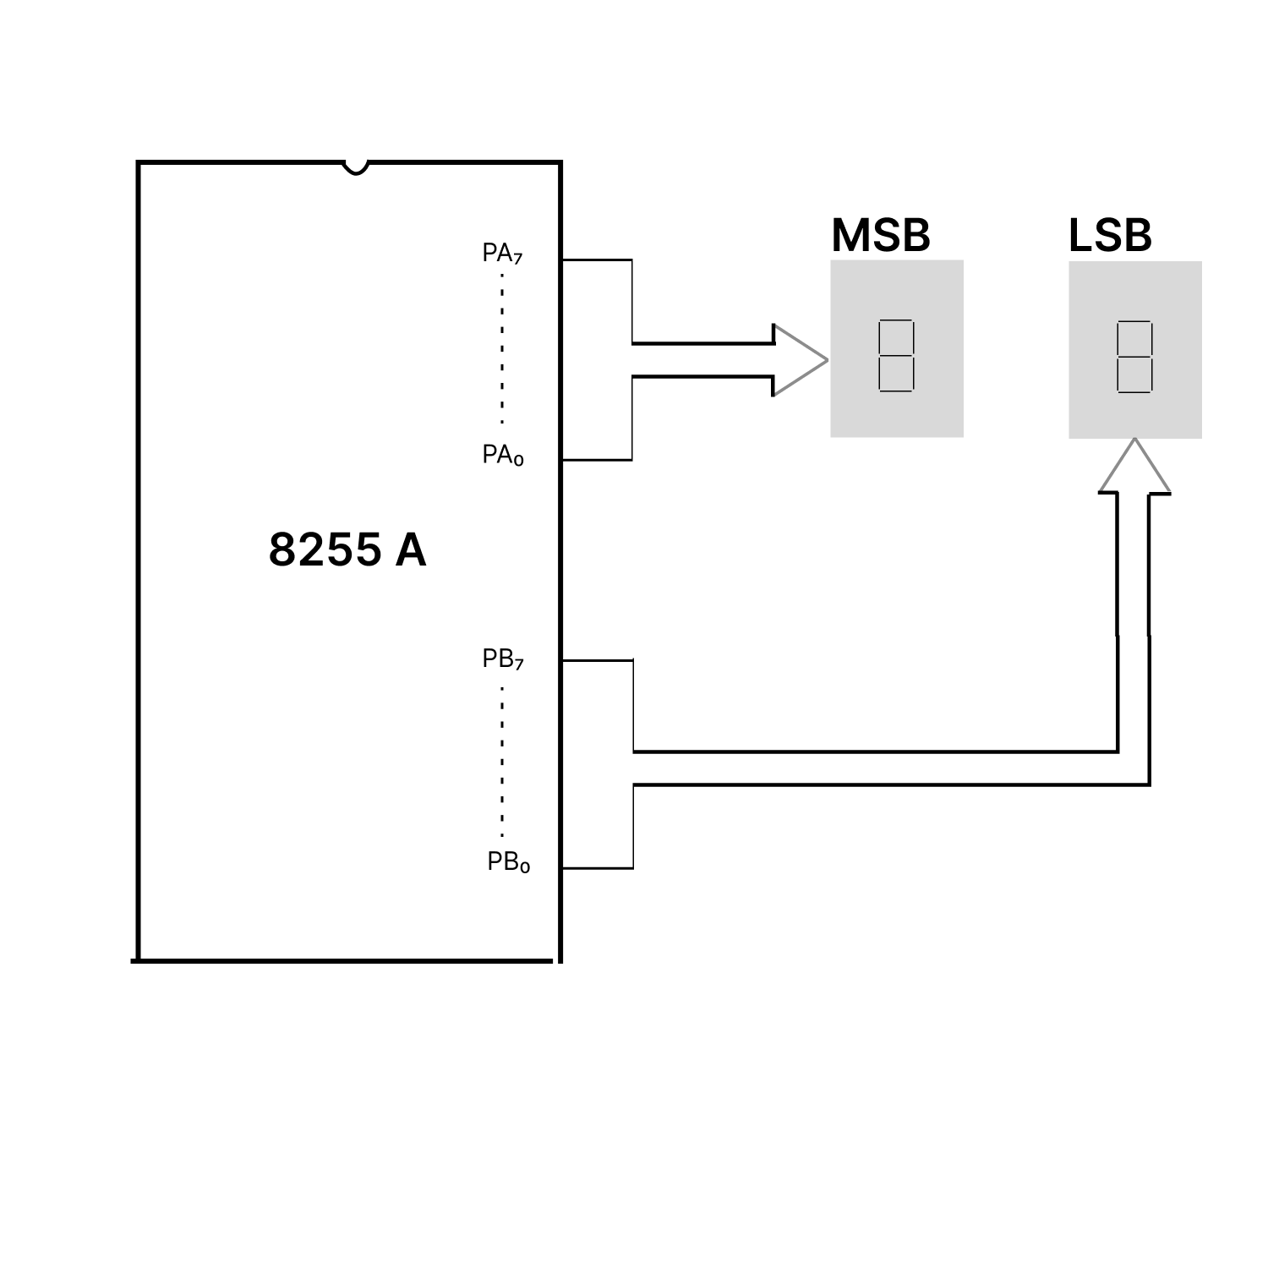
Seven Segment Display Interfacing

Slide 13
Flowchart

Slide 14
Applications of Smart AC system
01
02
INDUSTRIAL AUTOMATION
HOME AUTOMATION
On large scale this smart AC system can be used for efficient work and it will also save the electricity
It can also be used in day to day uses, this will start the AC depending upon the temperature label in room.

Slide 15
Advantages of Smart AC system
Smart AC system using 8085 is very simple circuit
As 8085 Microprocessor Memory used as stack memory (when needed), we the programmer can store already all possible combination of data corresponding to the temperature in the memory stack.
It has minimum circuitry.

Slide 16
Limitations of Smart AC system
The system is temperature bounded
We just conceptually say that huge no. of peripheral devices must be connected through the two port, but at the time of implementation we will not able to connect all possible devices with the microprocessor port.

Slide 17
Thank you

